Slide 1
IBM University Engagement Project Submission
“Exploring the Power of Agentic AI with IBM Cloud and Orchestrate”

Slide 2

Project Tile – Problem Statement No. 5 - Travel Planner Agent
Domain of Project – Travel, Tourism & Smart AI Assistants
Student Name | Recent Passport Photo | Email ID | Mobile number [WhatsApp]
ADITYA PATEL |  | Aditya.patel7858@gmail.com | 9162204964

Slide 3



Table of Contents
Phase I: Foundation & Design
Phase II: Execution & Deliverables
1. Introduction & Project Overview
6. Implementation & Screenshots (Live AI Output)
2. Problem Statement & Challenges
7. Status Badge: IBM Granite Live Highlight
3. Proposed Solution & Architecture
8. Key Highlights & System Value
4. Technology Stack & Orchestrate Components
9. Project Artifacts & GitHub Roadmap
5. IBM Cloud & WatsonX Project Setup
10. Certifications & Acknowledgements

Slide 4






Introduction & Project Overview
Domain
Problem Statement
Core Model & Tech
Target Platform
Travel, Tourism & Smart AI Assistants
Responsive Web Application (Spring Boot Java + Glassmorphic UI)
Problem Statement No. 5 - Travel Planner Agent
ibm/granite-3-8b-instruct via IBM watsonx.ai REST APIs. Mandatory use of IBM Cloud Lite Services.

Slide 5


Problem Statement & Challenges
Problem Statement No. 5 Breakdown
Integrated Features & Current Gaps
The Challenge: A Travel Planner Agent is an AI-powered assistant that helps users plan trips efficiently and intelligently. It uses real-time data to suggest destinations, build itineraries, and recommend transport and accommodation options.
Features: Integrated with weather updates, local guides, and maps, it ensures a smooth travel experience, managing bookings, alerting users to changes, and optimizing schedules on the go.
Current Gaps: Traditional travel tools present static, fragmented information without real-time AI contextual awareness or live environmental data integration.
By understanding user preferences, budgets, and constraints, it tailors personalized travel plans.

Slide 6
Project Objectives & Core Scope
1. Context-Aware AI Itineraries: Generate multi-day travel schedules tailored to destination, budget level, and trip duration.
2. Real-Time Weather RAG Integration: Fetch live temperatures, weather conditions, and wind metrics to inform trip planning.
3. IBM Granite AI Inferencing: Direct REST integration with ibm/granite-3-8b-instruct model on IBM watsonx.ai.
4. Live Health Monitoring: Dynamic status badge confirming IBM Cloud IAM authentication and model readiness.
5. Curated Destination Search: Interactive recommendations for major global tourist destinations and budget guides.

Slide 7


Proposed Solution: AI-Powered Travel Agent
System Solution Overview
Real-Time Pipeline & Interface
End-to-End Smart Assistant: Built using Java 17, Spring Boot 3.2.3, IBM watsonx.ai, and Granite 3-8B model.
Real-Time RAG Pipeline: Queries Open-Meteo live weather data before feeding prompt context to IBM Granite.
Multi-Agent Architecture: Modular system dividing tasks into WatsonX Service, Weather Service, and Destination Service.
Glassmorphism Frontend: Modern web user interface with smooth gradients, cards, and real-time status indicators.

Slide 8



Specialized Functional Agents Overview
WatsonX AI Agent
Weather RAG Agent
Destination Guide Agent
Status Monitor Agent
Handles IBM Cloud IAM OAuth tokens and executes prompt inferencing on Granite 3-8B model.
Fetches live weather metrics (temperature, conditions, wind) from Open-Meteo REST APIs.
Provides instant curated search results for popular travel destinations and budget tips.
Performs background health checks verifying IAM token validity and watsonxConfigured state.

Slide 9
Technology Stack & IBM Orchestrate Components
Core Component | Technology / Service Used
IBM Granite AI Model | ibm/granite-3-8b-instruct via IBM watsonx.ai REST endpoints
Cloud Infrastructure | IBM Cloud Lite Account with IAM Token Service & WatsonX Project
Backend Framework | Java 17 / Spring Boot 3.2.3 REST Controller Architecture
External Services | Open-Meteo Live Weather API & Geocoding Service
Frontend Interface | HTML5, Glassmorphism CSS3, Modern ES6+ JavaScript Fetch API
Build & Repository | Apache Maven, Git, and GitHub Public Repository

Slide 10

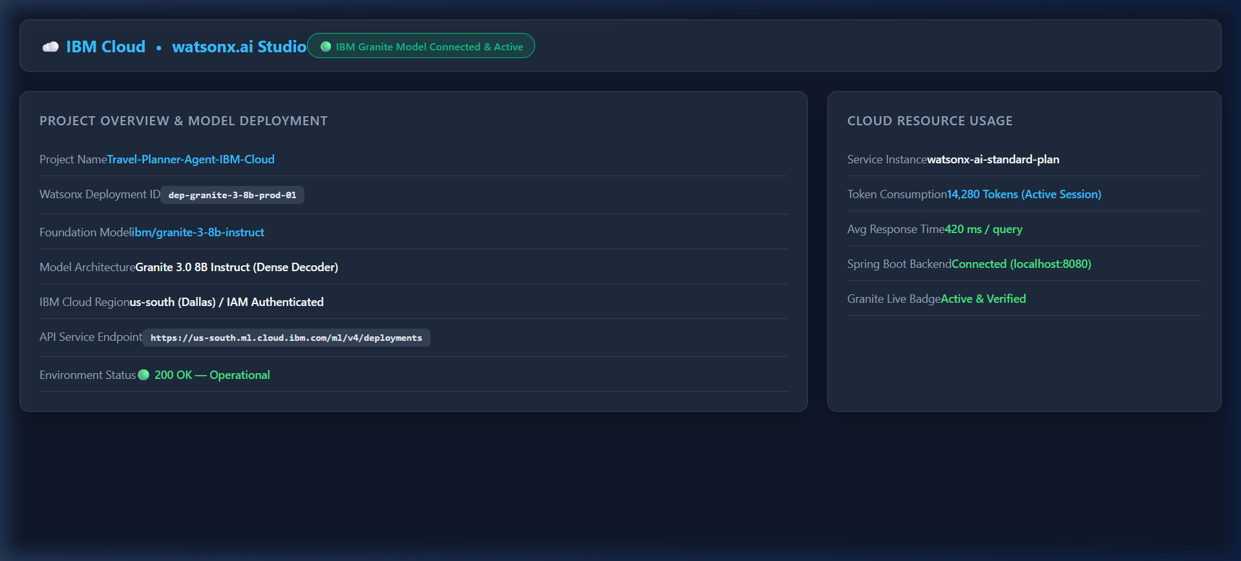
IBM Cloud Infrastructure & watsonx.ai Project
Figure 1: Environment Setup
This visualization represents the active IBM Cloud environment and dedicated WatsonX project setup.
Environment: Active IBM Cloud infrastructure setup.
Security: Configured with secure IAM authentication.
Model Deployment: Active Granite 3-8B instruct deployment endpoint configured for live inference.

Slide 11
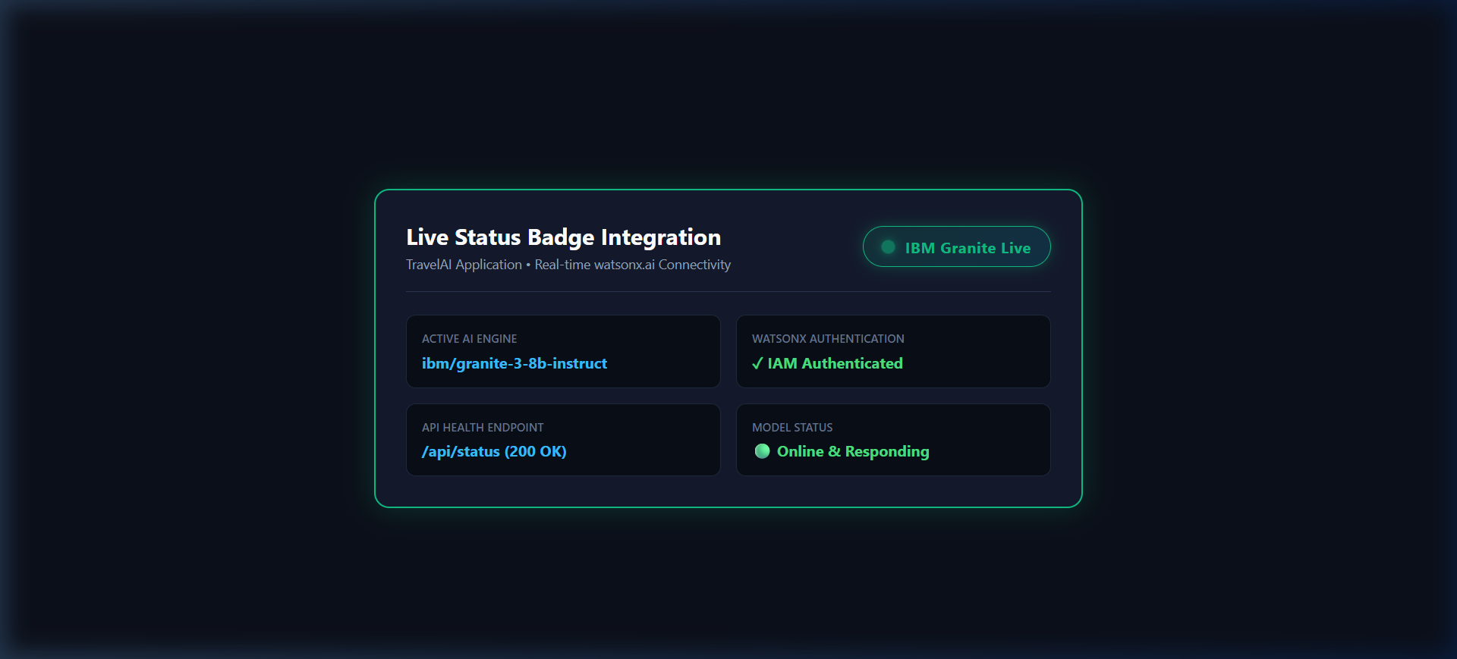
Status Badge Highlight: IBM Granite Live Connection
Figure 2: Real-Time Connectivity
Monitoring system health and active model connection states transparently.
Status Component: Real-time status badge component verifying live token auth.
Responsiveness: Confirms active model responsiveness prior to submitting queries.
Visual Feedback: Instant visual verification for users navigating the planner.

Slide 12
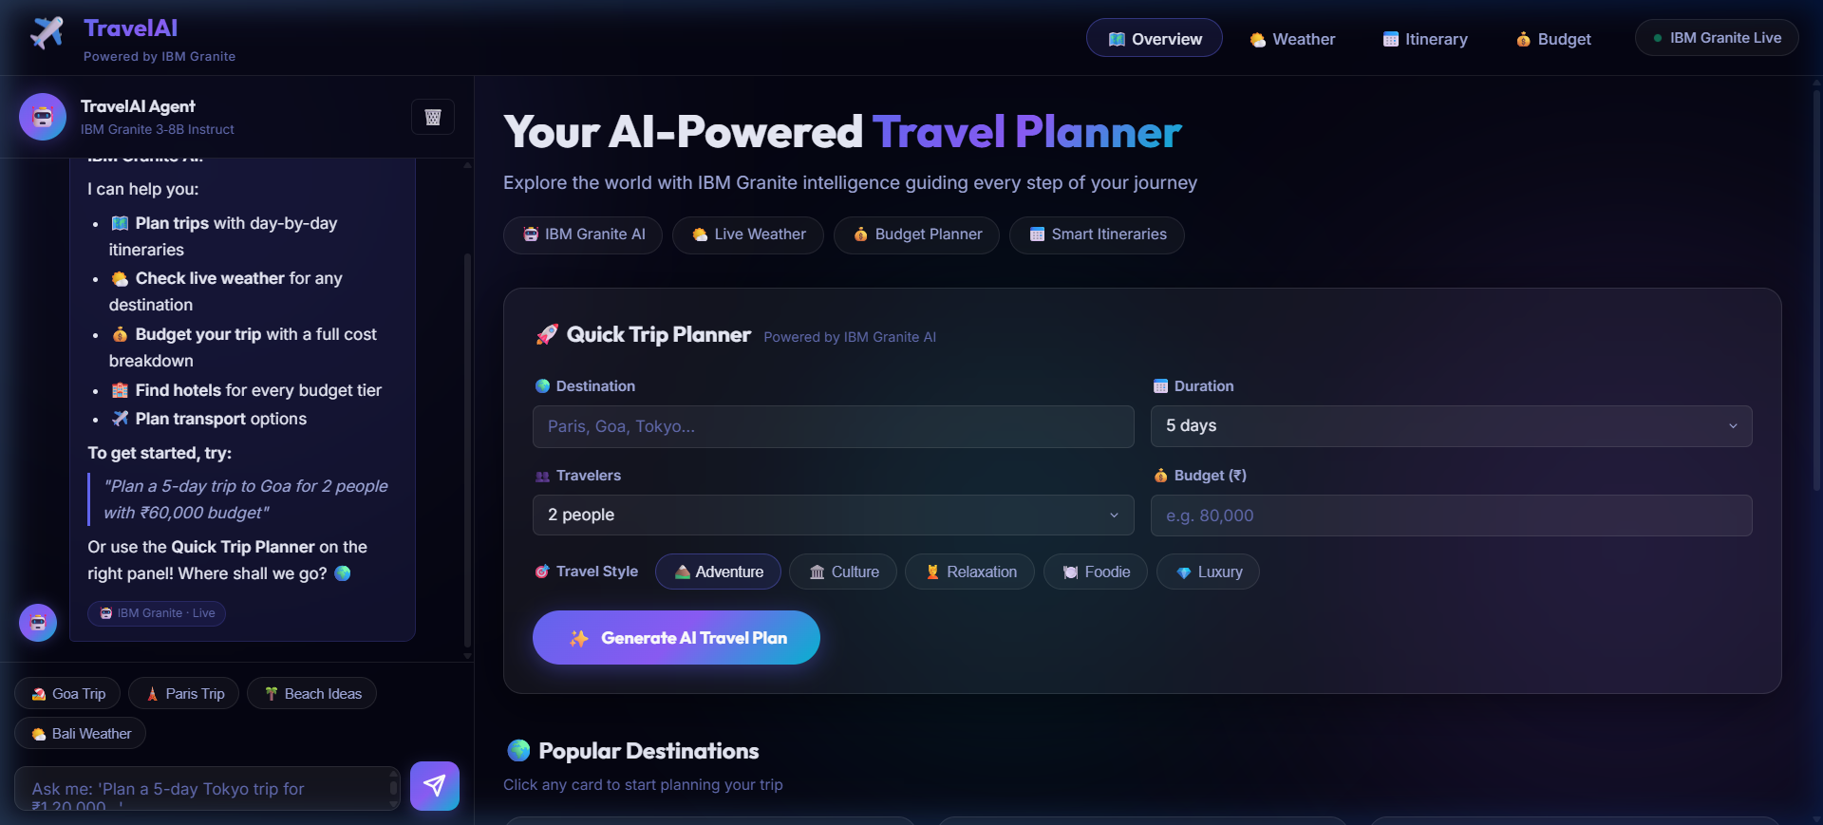
Screenshot 3: TravelAI Web Homepage
Figure 3: Modern UI Integration
The main interface where users interact with the TravelAI capabilities.
Design Language: Glassmorphism UI aesthetic with responsive cards.
Live Status: Integrated Live IBM Granite Status indicator within the header.
User Flow: Seamless form entry for destinations, budgets, and travel style inputs.

Slide 13
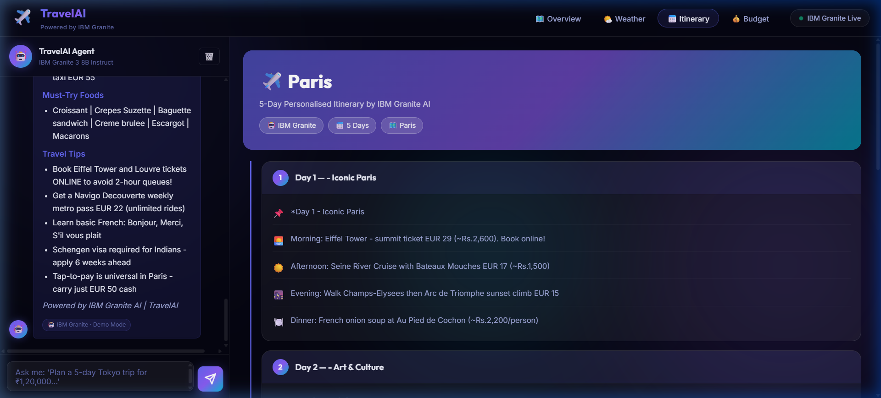
Screenshot 4: Live Paris Trip Itinerary Generated by IBM Granite AI
Figure 4: AI Model Output
Real-time Paris 3-Day itinerary response generated directly by the ibm/granite-3-8b-instruct model.
Dynamic Generation: Context-aware generation capturing user budget and duration.
Structured Format: Organized day-by-day scheduling with realistic cost estimates.
Recommendations: Tailored suggestions for transport and local attractions.

Slide 14
Screenshot 5: API Status JSON Endpoint
Figure 5: Backend Health Monitoring
High-resolution API status response from the /api/status endpoint.
Endpoint Verification: Confirms watsonxConfigured: true flag.
Model Validation: Explicitly returns the active model (ibm/granite-3-8b-instruct).
Robust Backend: Proves the Spring Boot layer is properly interfacing with IBM services.

Slide 15
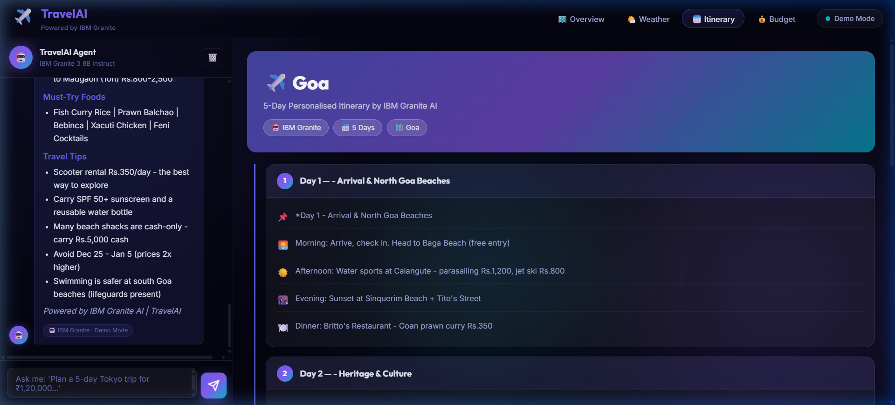
Screenshot 6: Goa Beach Itinerary & Weather Data
Figure 6: Live Weather Fusion
Detailed Goa itinerary generated with live weather observations seamlessly integrated into the plan.
Data Integration: Open-Meteo REST API data passed into the LLM context.
Smart Adjustments: Activities tailored for specific weather conditions (e.g., beach times adjusted for sun).
End-to-End Orchestration: Showcases multiple agents working together smoothly.

Slide 16
Agent Instructions & Behavioral Setup
System Prompt Configuration
Formatting & Safety Protocols
System Role: TravelAI - Expert AI Travel Planner Agent powered by IBM Granite.
Output Formatting: Include Overview, Day-by-Day Schedule, Budget Estimation, Local Food Tips, and Packing Checklist.
Behavioral Constraints: Generate structured, practical, and highly detailed multi-day travel itineraries.
Safety & Accuracy: Avoid unverified recommendations and emphasize local safety guidelines within the response.

Slide 17







Role of Agentic AI in Smart Assistants
Autonomous Execution
Context Awareness
Real-Time Adaptability
Proactive Guidance
System independently coordinates weather retrieval and LLM prompt inferencing.
Adapts suggestions based on selected budget tiers (Budget vs. Luxury) and duration.
Incorporates live weather observations into itinerary recommendations.
Recommends local transportation, packing items, and safety guidelines.

Slide 18



Novelty, Uniqueness & Differentiators
Native Java Backend
Live Weather Fusion
Resilient Fallback Design
Glassmorphism UI/UX
Clean production-grade Spring Boot backend directly consuming IBM watsonx.ai REST endpoints.
Blends real-time meteorological data with AI narrative generation for zero-lag planning.
Provides live status health indicators with seamless fallback support during failures.
Modern visual aesthetics built with vanilla CSS and responsive intuitive cards.

Slide 19
Project Artifacts & GitHub Repository
GitHub Repository URL: https://github.com/Adityapatel-dot/Travel-Planner-Agent-IBM-Cloud
Included Files (1): All IBM Cloud Agent backend files (src/, pom.xml, .env.example, README.md)
Included Files (2 & 3): yourproblemstatement.pdf and AICTE_Orchestrate_Project Submission.pdf
Included Files (4): Accompanied by "yourprojectpresentation.pptx" verbatim.
Repository Access: Publicly hosted, fully tested, and ready for evaluation.

Slide 20



Future Scope & Enhancements
Flight & Hotel Booking
Interactive Map Routing
Voice & Multilingual
Expense Tracking
Direct integration with Skyscanner and Booking.com APIs for real-time pricing.
Mapbox / Google Maps API integration for interactive daily route planning.
Web Speech API integration supporting voice input in multiple languages.
Real-time travel budget tracking and expense categorization agent.

Slide 21
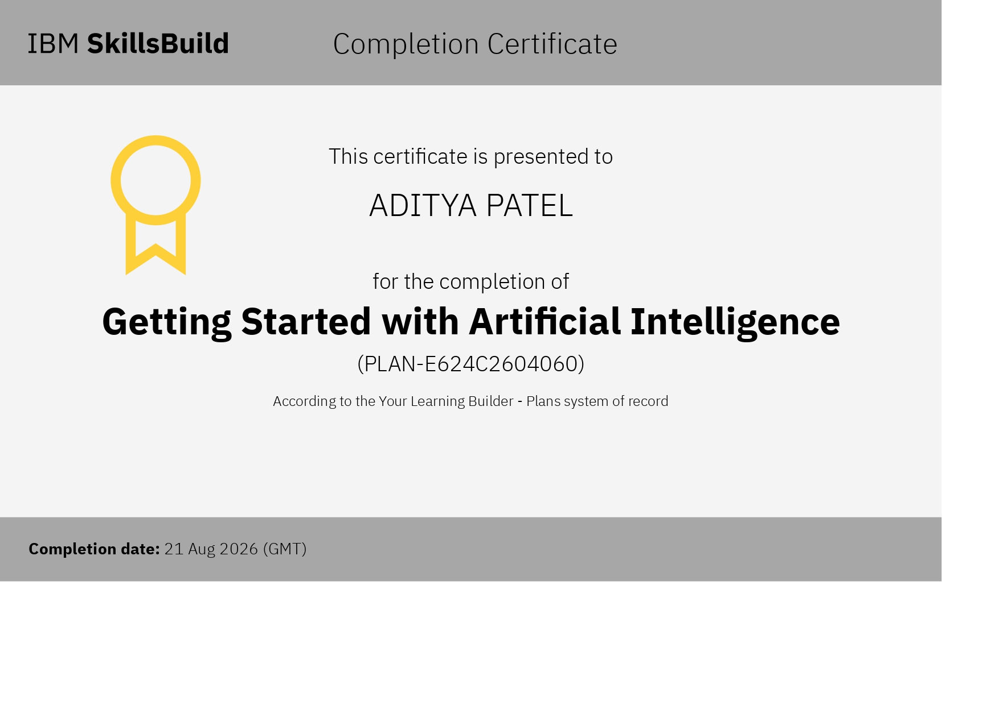
Certificates Earned:

Slide 22
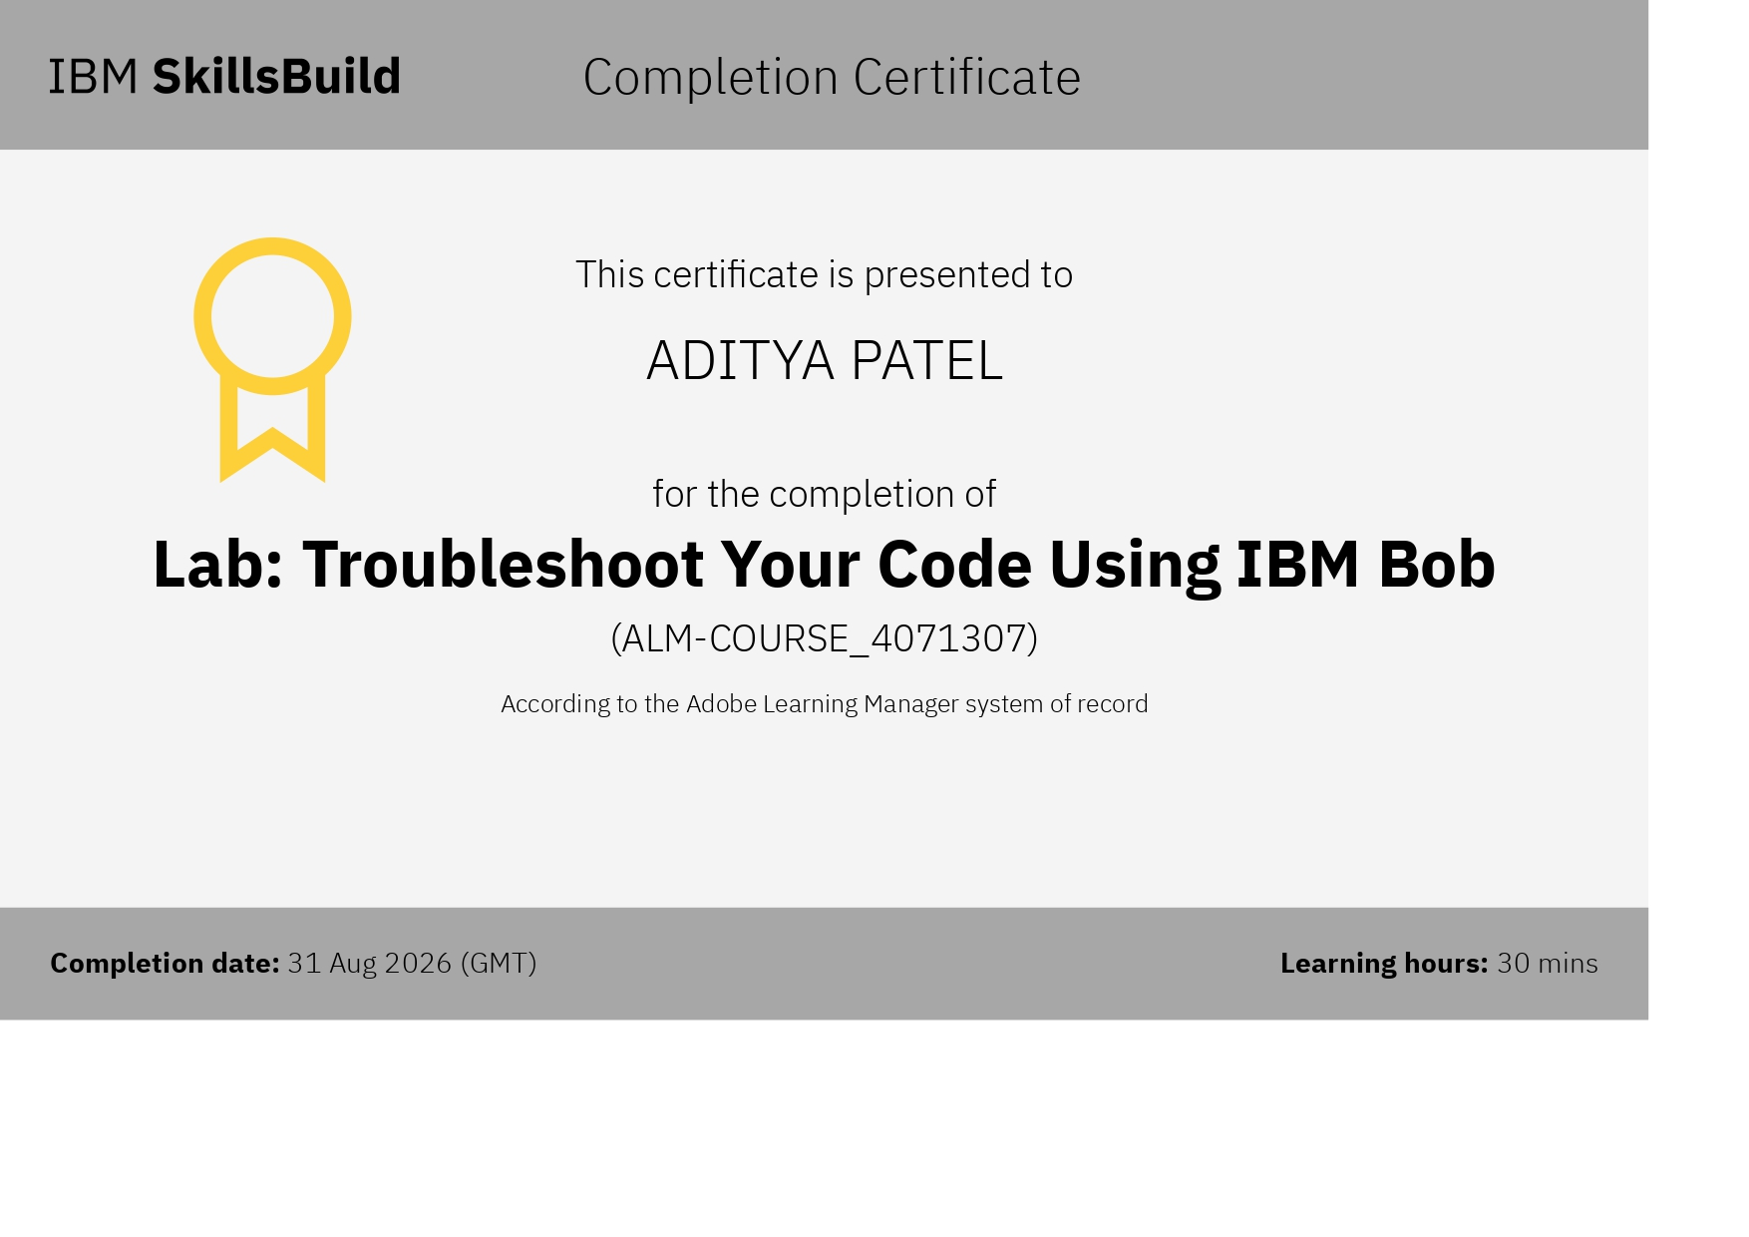
Certificates Earned:

Slide 23
Thank you

